Slide 1

Improvi
Go, change the world
RV College of
Engineering
Unit 3 (Relational Database Design)
Original Content: Ramez Elmasri and Shamkant B. Navathe
Dr. Poonam Ghuli
Associate Professor, Department of CSE
RV College of Engineering, Bengaluru - 59

Slide 2

Contents
Go, change the world
RV College of
Engineering
1 Informal Design Guidelines for Relational Databases
1.1 Semantics of the Relation Attributes
1.2 Redundant Information in Tuples and Update Anomalies
1.3 Null Values in Tuples
1.4 Spurious Tuples
2 Functional Dependencies (FDs)
2.1 Definition of FD
2.2 Inference Rules for FDs
2.3 Equivalence of Sets of FDs
3 Normal Forms Based on Primary Keys
3.1 Introduction to Normalization
3.2 First Normal Form
3.3 Second Normal Form
3.4 Third Normal Form
4 General Normal Form Definitions (For Multiple Keys)
5 BCNF (Boyce-Codd Normal Form)

Slide 3
Informal Design Guidelines for Relational Databases
Go, change the world
RV College of
Engineering
GUIDELINE 1: Informally, each tuple in a relation should represent one entity or relationship instance. (Applies to individual relations and their attributes).
Attributes of different entities (EMPLOYEEs, DEPARTMENTs, PROJECTs) should not be mixed in the same relation
Only foreign keys should be used to refer to other entities
Entity and relationship attributes should be kept apart as much as possible.
Bottom Line: Design a schema that can be explained easily relation by relation. The semantics of attributes should be easy to interpret.

Slide 4
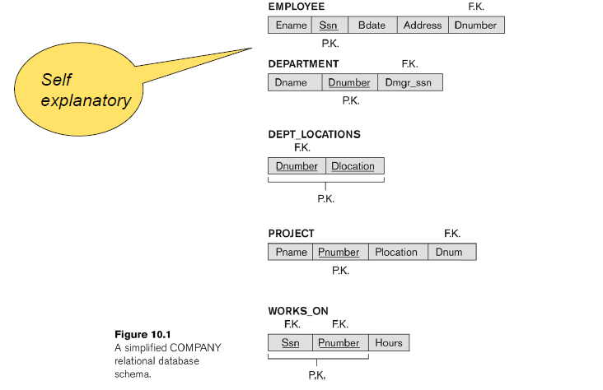
A Simplified Company Relational Schema
Go, change the world
RV College of
Engineering

Slide 5
Redundant Information in Tuples and Update Anomalies
Go, change the world
RV College of
Engineering
Big (and common) DB Problem:
In a ‗poorly designed‘ DB information is stored redundantly
Consequences:
Wastes storage
Causes problems with update anomalies
Insertion anomalies
Deletion anomalies
Modification anomalies

Slide 6
EXAMPLE OF AN UPDATE ANOMALY
Go, change the world
RV College of
Engineering
Consider the relation:
EMP_PROJ(Emp#, Proj#, Ename, Pname, No_hours)
Update Anomaly:
Changing the name of project number P1 from
“Billing” to "Customer-Accounting" may cause this update to be made for all 100 employees working on project P1.

Slide 7
Go, change the world
RV College of
Engineering
EXAMPLE OF AN INSERT ANOMALY
Consider the relation:
EMP_PROJ (Emp#, Proj#, Ename, Pname, No_hours)
Insert Anomaly:
Cannot insert a project unless an employee is assigned to it.
Conversely
Cannot insert an employee unless an he/she is assigned to a project.

Slide 8
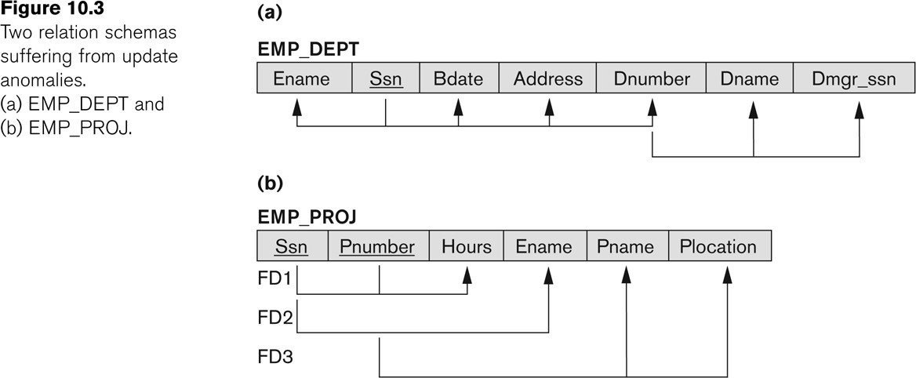
Go, change the world
RV College of
Engineering
Figure 10.3 Two relation schemas suffering from update anomalies

Slide 9
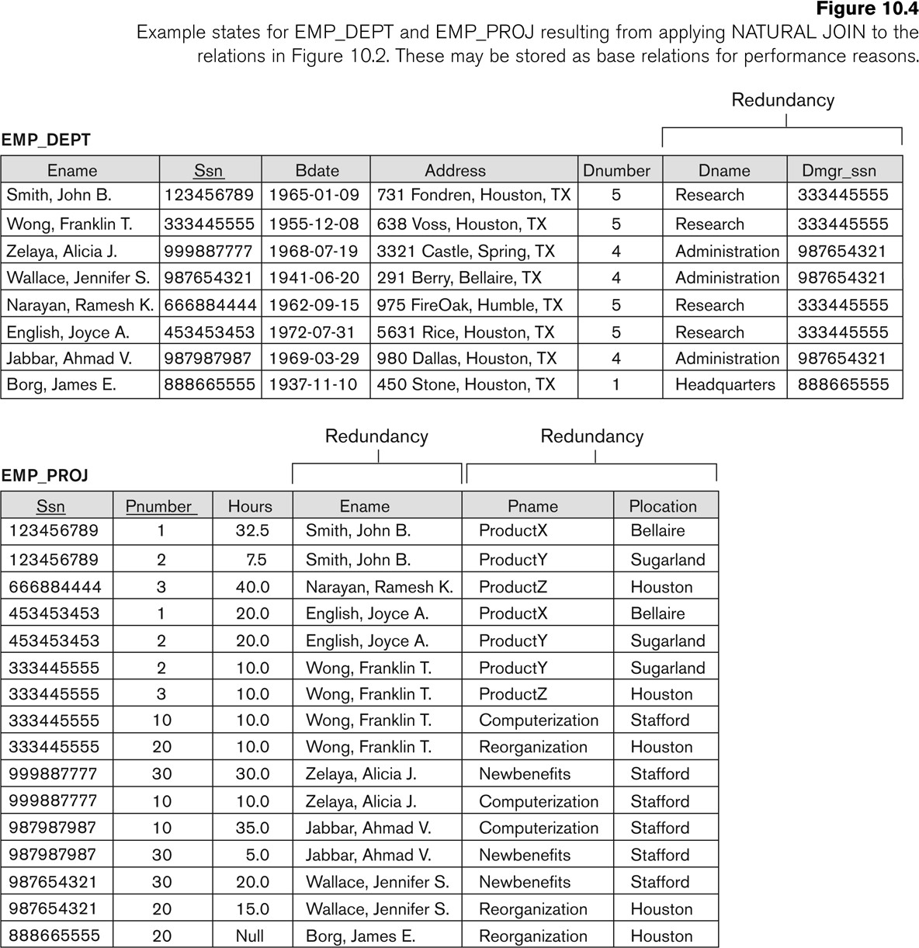
Figure 10.4 Example States for EMP_DEPT and EMP_PROJ
Go, change the world
RV College of
Engineering

Slide 10
Guideline to Redundant Information in Tuples and Update Anomalies
Go, change the world
RV College of
Engineering
GUIDELINE 2:
Design a schema that does not suffer from the insertion, deletion and update anomalies.
If there are any anomalies present, then note them so that applications can be made to take them into account.

Slide 11
Null Values in Tuples
Go, change the world
RV College of
Engineering
GUIDELINE 3:
Relations should be designed such that their tuples will have as few NULL values as possible
Attributes that are NULL frequently could be placed in separate relations (with the primary key)
Reasons for nulls:
Attribute not applicable or invalid
Attribute value unknown (may exist)
Value known to exist, but unavailable

Slide 12
Spurious Tuples
Go, change the world
RV College of
Engineering
Bad designs for a relational database may result in erroneous results for certain JOIN operations
The "lossless join" property is used to guarantee meaningful results for join operations
GUIDELINE 4:
The relations should be designed to satisfy the lossless join condition.
No spurious tuples should be generated by doing a natural-join of any relations.

Slide 13
Spurious Tuples (2)
Go, change the world
RV College of
Engineering
There are two important properties of decompositions:
Non-additive or losslessness of the corresponding join
Preservation of the functional dependencies.
Note that:
Property (a) is extremely important and cannot be sacrificed.
Property (b) is less stringent and may be sacrificed. (See in next Chapter ).

Slide 14


Spurious Tuples
Go, change the world
RV College of
Engineering
Consider relation r(ABCD)
A | B
1 | 2
1 | 0
2 | 0
2 | 2
and its projections r1(AB) and r2(BC).
A | B | C
1 | 2 | 3
1 | 2 | 4
1 | 0 | 4
1 | 0 | 1
… | … | …
2 | 0 | 4
2 | 0 | 1
2 | 2 | 3
A | B | C
1 | 2 | 3
1 | 2 | 4
1 | 0 | 4
2 | 0 | 1
2 | 2 | 3
Phantom records
B | C
2 | 3
2 | 4
0 | 4
0 | 1
2 | 3
Observation
Not all decompositions of a table can be combined using natural join to reproduce the original table.

Slide 15
Spurious Tuples
Go, change the world
RV College of
Engineering
Consider the following two relations r₁(ABC) and
A | B | C
1 | 2 | 3
4 | 2 | 3
2 | 2 | 6
3 | 1 | 4
B | C | D
2 | 3 | 4
2 | 3 | 5
1 | 4 | 2
r (BCD).
A | B | C | D
1 | 2 | 3 | 4
1 | 2 | 3 | 5
4 | 2 | 3 | 4
4 | 2 | 3 | 5
3 | 1 | 4 | 2
Compute natural join r = r₁ r₂
Evaluate projections
A | B | C
1 | 2 | 3
4 | 2 | 3
3 | 1 | 4
B | C | D
2 | 3 | 4
2 | 3 | 5
1 | 4 | 2
r ‘= (r) and r ‘ =
Observation
Tables r₂ and r₂‘ are the same however tuple <2,2,6>  r₁ but not present in r₁‘

Slide 16
Functional Dependencies
Go, change the world
RV College of
Engineering
Functional dependencies (FDs) are used to specify formal measures of the "goodness" of relational designs
FDs and keys are used to define normal forms for relations
FDs are constraints that are derived from the meaning and interrelationships of the data attributes
FD is a constraint between two sets of attributes
A set of attributes X functionally determines a set of attributes Y if the value of X determines a unique value for Y

Slide 17
Functional Dependencies
Go, change the world
RV College of
Engineering
X → Y holds if whenever two tuples have the same value for X, they must have the same value for Y
For any two tuples t1 and t2 in any relation instance r(R):
If t1[X]=t2[X],
then t1[Y]=t2[Y]
X → Y in R specifies a constraint on all relation instances r(R)
Written as X → Y; can be displayed graphically on a relation schema as in Figures. ( denoted by the arrow: ).
FDs are derived from the real-world constraints on the attributes

Slide 18
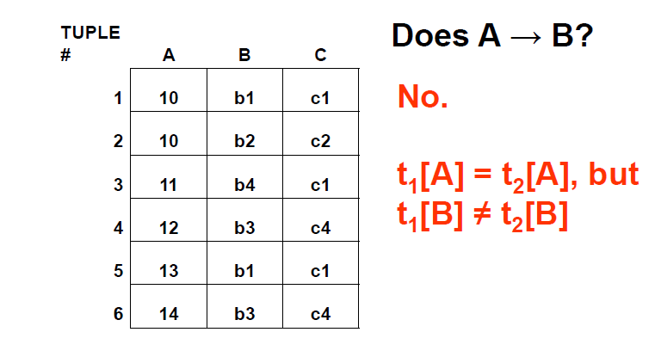
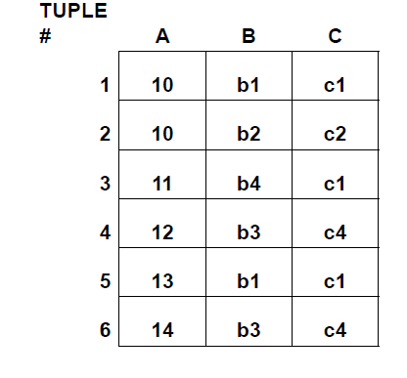
Example
Go, change the world
RV College of
Engineering
_{Does B→C}

Slide 19
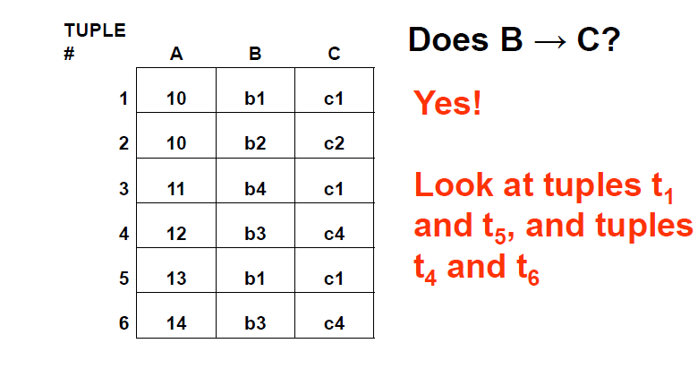
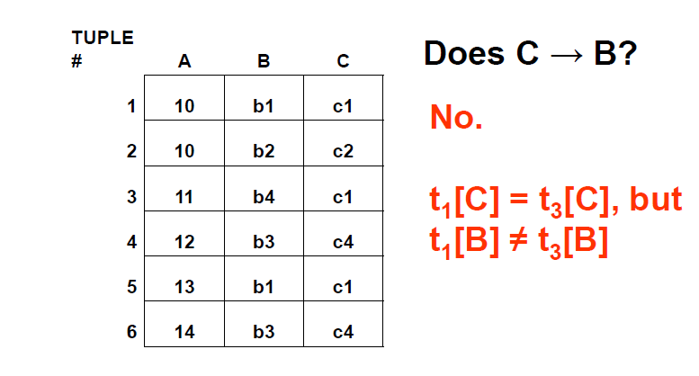
Examples of FD constraints
Go, change the world
RV College of
Engineering

Slide 20
Examples of FD constraints
Go, change the world
RV College of
Engineering
social security number determines employee name
SSN -> ENAME
project number determines project name and location
PNUMBER -> {PNAME, PLOCATION}
employee ssn and project number determines the hours per week that the employee works on the project
{SSN, PNUMBER} -> HOURS

Slide 21
Examples of FD constraints
Go, change the world
RV College of
Engineering
An FD is a property of the attributes in the schema R
The constraint must hold on every relation instance r(R)
If K is a key of R, then K functionally determines all attributes in R (since we never have two distinct tuples with t1[K]=t2[K])
FDs must hold for all valid states of a relation, not just current state
So define FDs carefully!

Slide 22
Go, change the world
RV College of
Engineering
How do we identify FDs?
Likely, some FDs will be obvious or identified in initial design of DB
Vehicle(tagno, regstate, owner, make, model, year, gaseconomy, dealership, dealeraddr)
{tagno, regstate} → owner
{tagno, regstate} → {make, model, year}
{make, model, year} → gaseconomy,
dealership → dealeraddr etc…

Slide 23
How do we identify FDs?
Go, change the world
RV College of
Engineering
But the algorithms we use to test for other properties of good DB design often need to know ALL FDs!
Some FDs may not be obvious, but can be deduced from other FDs
Given a set of FDs F for a relation R, the set of all FDs for R is F⁺
(known as the closure of F)

Slide 24
Inferring FDs
Go, change the world
RV College of
Engineering
Ex: (SSN, PNUMBER, HOURS, ENAME, PNAME, PLOCATION)
SSN → ENAME,
{SSN, PNUMBER} → HOURS, PNUMBER → PNAME, PNUMBER → PLOCATION
PNUMBER → PNAME,
so {PNUMBER, HOURS} → PNAME
PNUMBER → PNAME and PNUMBER → PLOCATION, so PNUMBER → {PNAME, PLOCATION}
25

Slide 25
Inference Rules for FDs
Go, change the world
RV College of
Engineering
Given a set of FDs F, we can infer additional FDs that hold whenever the FDs in F hold
Armstrong's inference rules:
IR1. (Reflexive) If Y subset-of X, then X -> Y
IR2. (Augmentation) If X -> Y, then XZ -> YZ
(Notation: XZ stands for X U Z)
IR3. (Transitive) If X -> Y and Y -> Z, then X -> Z
IR1, IR2, IR3 form a sound and complete set of inference rules

Slide 26
Inference Rules for FDs
Go, change the world
RV College of
Engineering
Some additional inference rules that are useful:
(Decomposition) If X -> YZ, then X -> Y and X -> Z
(Union) If X -> Y and X -> Z, then X -> YZ
(Psuedotransitivity) If X -> Y and WY -> Z, then WX -> Z
The last three inference rules, as well as any other inference rules, can be deduced from IR1, IR2, and IR3 (completeness property)

Slide 27
Inference Rules for FDs
Go, change the world
RV College of
Engineering
Closure of a set F of FDs is the set F⁺ of all FDs that can be inferred from F
Closure of a set of attributes X with respect to F is the set X ⁺ of all attributes that are functionally determined by X
X ⁺ can be calculated by repeatedly applying IR1, IR2, IR3 using the FDs in F

Slide 28
Closure of X under F (X⁺)
Go, change the world
RV College of
Engineering
X⁺ = set of all attributes dependent on X
Algorithm
start with X⁺ = X
for each FD Y → Z in F do
if Y is a subset of X⁺ then X⁺ = X⁺ U Z
Continue this process until no more attributes can be added to X⁺

Slide 29
Example
Go, change the world
RV College of
Engineering
Given a relation Student and a set of functional dependencies F as follows, compute the closure for all LHS.
Student(SID, dept, dept_chair)
F = { SID → {dept, dept_chair}, dept → dept_chair,
{SID, dept} → dept_chair }
{SID}⁺ = {SID, dept, dept_chair}
{dept}⁺ = {dept, dept_chair}
{SID, dept} ⁺ = {SID, dept, dept_chair}
If the closure of a LHS includes all attributes, then this LHS is a super key of the relation.

Slide 30
Candidate Keys
Go, change the world
RV College of
Engineering
If X⁺ contains all attributes in a relation R, and if there does not exist Y in X
such that (X – Y)⁺ = all attributes in R, then X is a candidate key for R
In previous example, {SID,dept}⁺ includes all attributes, SID⁺ also includes all attributes.
SID is a candidate key

Slide 31
Exercise
Go, change the world
RV College of
Engineering
R(A,B,C,D,G,H)
F = { A → B, B → C, CD → H, BC →G}
What is the closure of AC?

Slide 32
Equivalence of Sets of FDs
Go, change the world
RV College of
Engineering
Two sets of FDs F and G are equivalent if:
- every FD in F can be inferred from G, and
- every FD in G can be inferred from F
Hence, F and G are equivalent if F ⁺ =G ⁺
Definition: F covers G if every FD in G can be inferred from F (i.e., if G ⁺ subset-of F ⁺)
F and G are equivalent if F covers G and G covers F
There is an algorithm for checking equivalence of sets of FDs

Slide 33
Go, change the world
RV College of
Engineering
Example of Equivalent FD sets
F1 = { SID → {dept, dept_chair}, dept → dept_chair,
{SID, dept} → dept_chair }
F2 = { SID → {dept, dept_chair}, dept → dept_chair}
F1 covers F2
Only need to check if F2 can also infer F1
i.e. Can we generate the set of FDs in F1 using FDs defined in F2?
Compute {SID,dept}⁺ based on F2
Its closure includes all attributes
We can conclude that {SID,dept} → dept_chair

Slide 34
Minimal Sets of FDs
Go, change the world
RV College of
Engineering
A set of FDs is minimal if it satisfies the following conditions:
Every dependency in F has a single attribute for its RHS.
We cannot remove any dependency from F and have a set of dependencies that is equivalent to F.
We cannot replace any dependency X -> A in F with a dependency Y -> A, where Y proper-subset-of X ( Y subset-of X) and still have a set of dependencies that is equivalent to F.

Slide 35
Minimal Sets of FDs
Go, change the world
RV College of
Engineering
Every set of FDs has an equivalent minimal set
There can be several equivalent minimal sets
There is no simple algorithm for computing a minimal set of FDs that is equivalent to a set F of FDs

Slide 36
Algorithm
Go, change the world
RV College of
Engineering
Given a set of FDs F, find its minimal cover
Step1: Decompose each FD to get single attribute at RHS
Step2: For each FD, remove redundant attribute from LHS
Step3: Remove redundant FDs

Slide 37
Example
Go, change the world
RV College of
Engineering
Given F= {B → AB, D → A, AB → D}
Step 1: B → AB is decomposed into B → A, B → B
(B → B is trivial and is removed)
Step 2: check if AB → D has redundant LHS. Can it be A → D or B → D?
Compute AB⁺, A⁺, B⁺ based on F
AB⁺ = ABD and B⁺ = ABD, so A is extraneous.
So far, we have F= {B → A, D → A, B → D}

Slide 38
Example (cont.)
Go, change the world
RV College of
Engineering
So far, we have F= {B → A, D → A, B → D}
Step 3: check if there is any redundant FDs. Is B → A redundant?
Compute B⁺ based on F- {B → A}
B⁺ = BDA, that means we can obtain
B → A from F- {B → A} so B → A is redundant.
Similarly, check the remaining FDs.
Final answer F’ = {D → A, B → D}

Slide 39
Exercise
Go, change the world
RV College of
Engineering
Given a set of FDs F, find its minimal cover
Step1: Decompose each FD to get single attribute at RHS
Step2: For each FD, remove redundant attribute from LHS
Step3: Remove redundant FDs
Question: what is the minimal cover of F?
R(A, B, C), F = {A → B, BC → A, AB → AC}

Slide 40
Minimal Set (Cover) of FDs
Go, change the world
RV College of
Engineering
There can be more than one minimal cover for a relation
They won’t necessarily have the same number of FDs

Slide 41
Normalization of Relations
Go, change the world
RV College of
Engineering
Normalization: The process of decomposing unsatisfactory "bad" relations by breaking up their attributes into smaller relations
Normal form: Condition using keys and FDs of a relation to certify whether a relation schema is in a particular normal form

Slide 42
Normalization of Relations
Go, change the world
RV College of
Engineering
2NF, 3NF, BCNF
based on keys and FDs of a relation schema
4NF
based on keys, multi-valued dependencies : MVDs; 5NF based on keys,
Join dependencies : JDs (Chapter 11)
Additional properties may be needed to ensure a good relational design (lossless join, dependency preservation; Chapter 11)

Slide 43
Practical Use of Normal Forms
Go, change the world
RV College of
Engineering
Normalization is carried out in practice so that the resulting designs are of high quality and meet the desirable properties
The practical utility of these normal forms is questionable when the constraints on which they are based are hard to understand or to detect
The database designers need not normalize to the highest possible normal form
(usually up to 3NF, BCNF or 4NF)
Denormalization:
The process of storing the join of higher normal form relations as a base relation—which is in a lower normal form

Slide 44
Definitions of Keys and Attributes Participating in Keys
Go, change the world
RV College of
Engineering
A superkey of a relation schema R = {A1, A2, ...., An} is a set of attributes S subset-of R with the property that no two tuples t1 and t2 in any legal relation state r of R will have t1[S] = t2[S]
A key K is a superkey with the additional property that removal of any attribute from K will cause K not to be a superkey any more.

Slide 45
Definitions of Keys and Attributes Participating in Keys
Go, change the world
RV College of
Engineering
If a relation schema has more than one key, each is called a candidate key.
One of the candidate keys is arbitrarily designated to be the primary key, and the others are called secondary keys.
A Prime attribute must be a member of some candidate key
A Nonprime attribute is not a prime attribute—that is, it is not a member of any candidate key.

Slide 46
First Normal Form 1NF
Go, change the world
RV College of
Engineering
A relation scheme R is in first normal form (1NF) if the values in dom (A) are atomic for every attribute A in R.
Disallows
composite attributes
Set-valued attributes
nested relations; a cell of an individual tuple is a complex relation

Slide 47
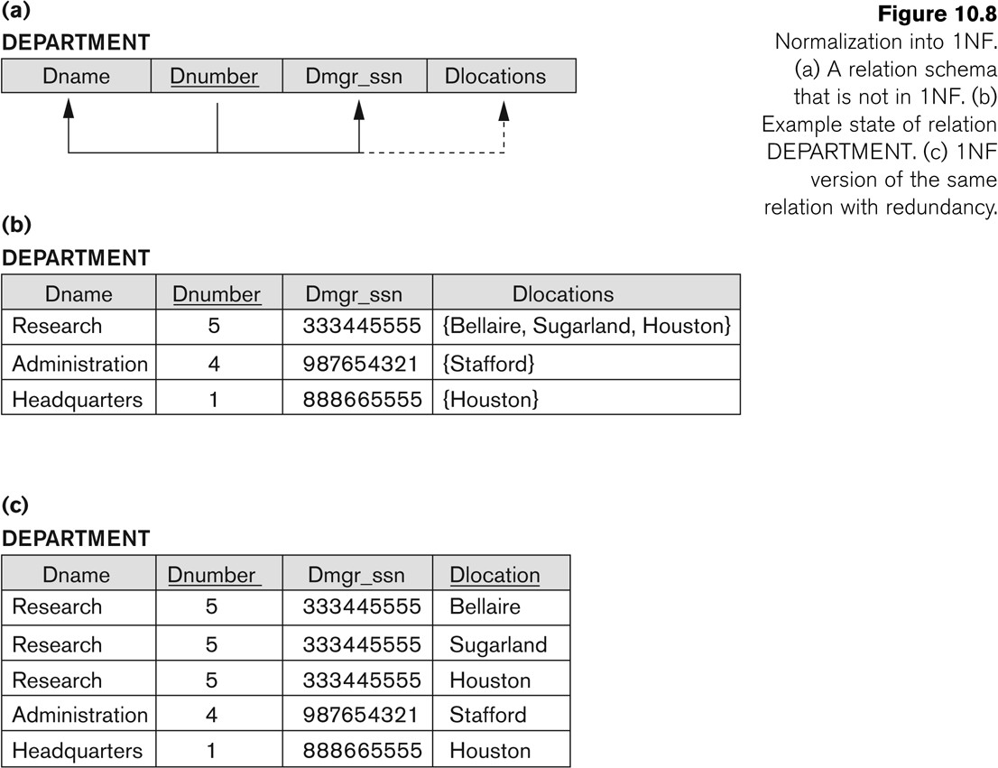
First Normal Form 1NF
Go, change the world
RV College of
Engineering

Slide 48
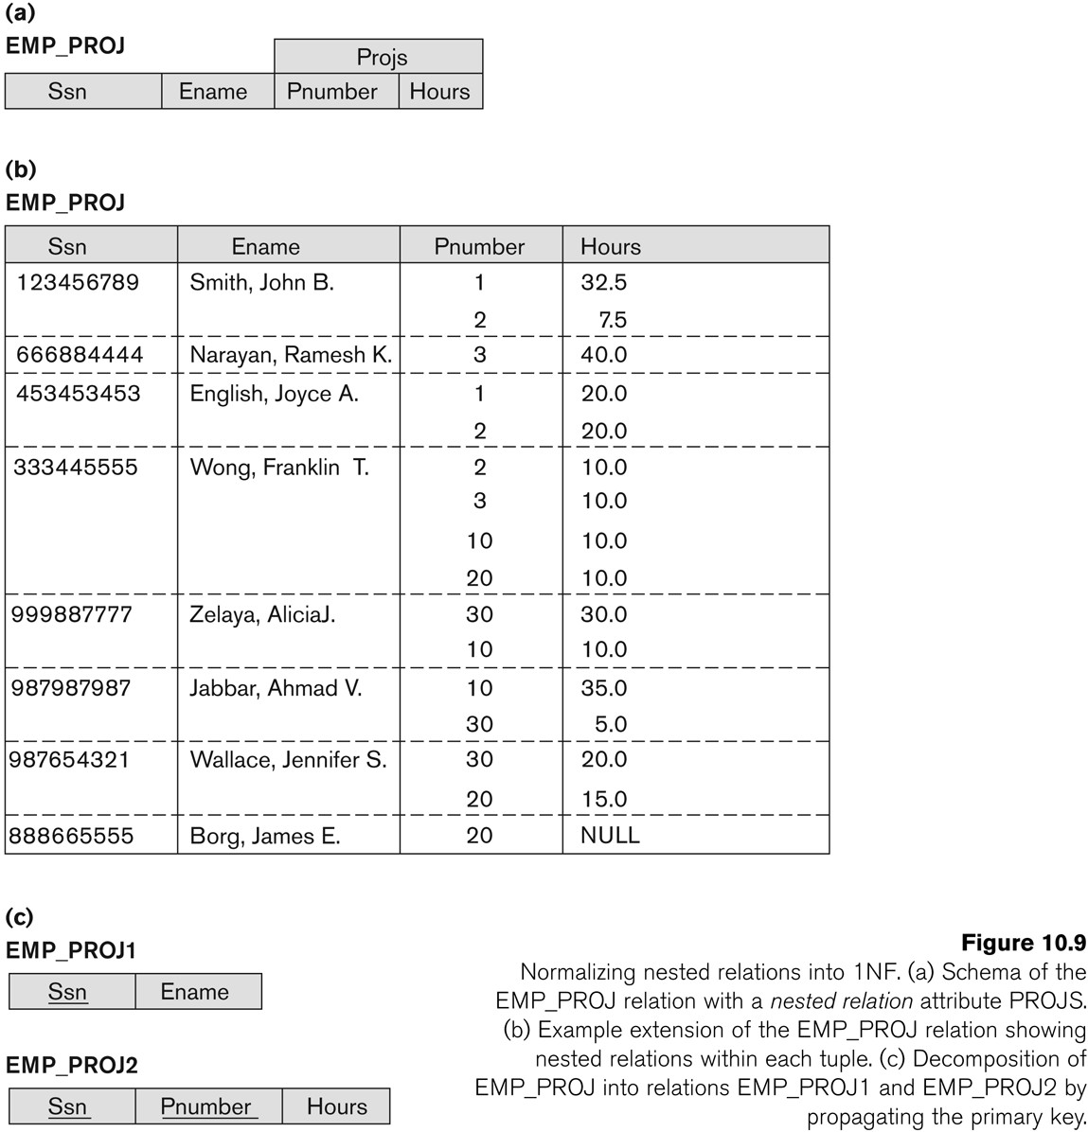
Normalization nested relations into 1NF
Go, change the world
RV College of
Engineering
Composite attributes

Slide 49
Second Normal Form
Go, change the world
RV College of
Engineering
Uses the concepts of FDs, primary key
Definitions
Prime attribute: An attribute that is member of the primary key K
Left-Reduced or Full functional dependency: a FD Y → Z where removal of any attribute from Y means the FD does not hold any more
Examples:
{SSN, PNUMBER} → HOURS is a full FD since neither SSN  HOURS nor PNUMBER → HOURS hold
{SSN, PNUMBER} → ENAME is not a full FD (it is called a partial dependency ) since SSN →ENAME also holds

Slide 50
Second Normal Form
Go, change the world
RV College of
Engineering
A relation scheme R is in second normal form (2NF) with respect to a set of FDs F if it is in 1NF and every nonprime attribute is fully dependent on every key of R.
R can be decomposed into 2NF relations via the process of 2NF normalization
Example
Let R=ABCD and F = { AB → C, B → D }. Here AB is a key. C and D are non-prime. C is fully dependent on the entire key AB, however D functionally depends on just part of the key (B →D). This is called a partial dependency

Slide 51
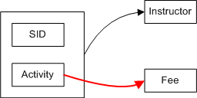
Second Normal Form
Go, change the world
RV College of
Engineering
Example
We deduce from the data sample
activity →fee,
sid activity →instructor
Key: {sid ,activity}. Non-key attributes: { Fee, Instructor }
There is a partial dependency therefore the schema is not 2NF
SID | Activity | Fee | Instructor
100 | Basket Ball | 200 | Lebron
100 | Golf | 65 | Arnold
200 | Golf | 65 | Jack
300 | Golf | 65 | Lebron

Slide 52
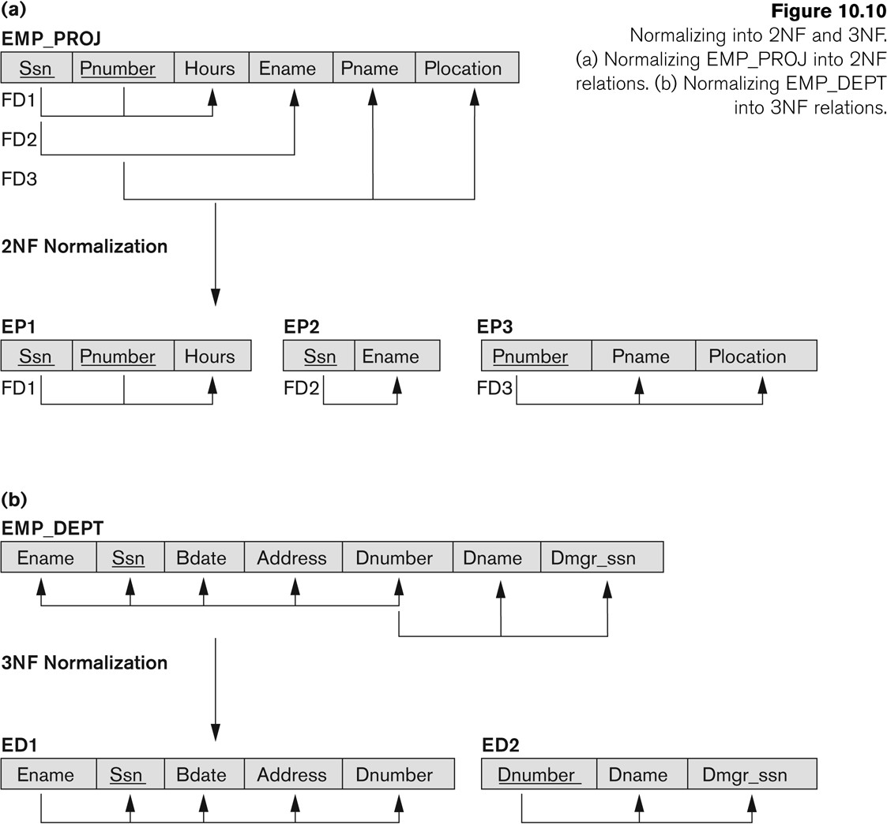
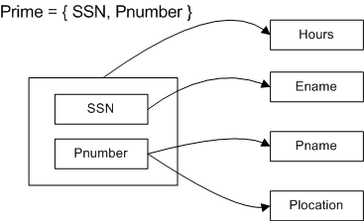
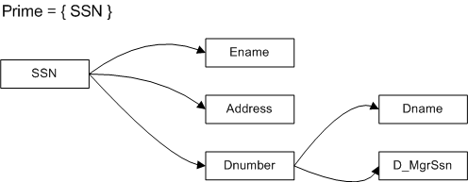
Normalizing into 2NF and 3NF
Go, change the world
RV College of
Engineering

Slide 53
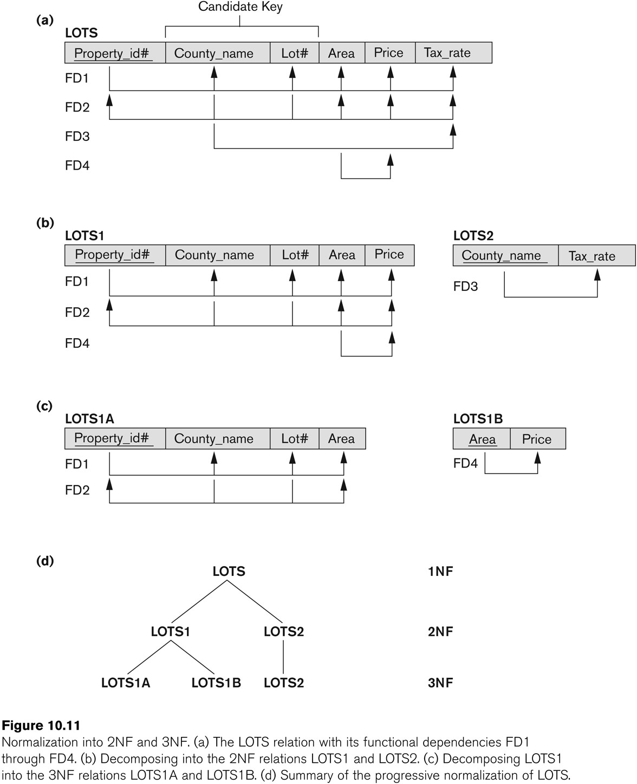
Normalization into 2NF and 3NF
Go, change the world
RV College of
Engineering

Slide 54

Third Normal Form
Go, change the world
RV College of
Engineering
Definition:
Given a relation scheme R, a subset X of R, an attribute A in R, and a set of FDs F, A is transitively dependent upon X in R if there is a subset Y of R with:
X →Y, Y→X and Y → A under F and AϵXY.
Examples:
Schema (ABCD) and F = {A →B, B →AC, C →D }
D is transitively dependent on A(and B) via C, however C is not transitively dependent on A via B (B is prime).

Slide 55
Third Normal Form
Go, change the world
RV College of
Engineering
A relation schema R is in third normal form (3NF) if it is in 2NF and no non-prime attribute A in R is transitively dependent on the primary key
R can be decomposed into 3NF relations via the process of 3NF normalization
NOTE:
In X → Y and Y → Z, with X as the primary key, we consider this a problem only if Y is not a candidate key.
When Y is a candidate key, there is no problem with the transitive dependency .
E.g., Consider EMP (SSN, Emp#, Salary ).
Here, SSN → Emp# → Salary and Emp# is a candidate key.

Slide 56
Go, change the world
RV College of
Engineering
Normal Forms Defined Informally
1st normal form
All attributes depend on the key
2nd normal form
All attributes depend on the whole key
3rd normal form
All attributes depend on nothing but the key

Slide 57
General Normal Form Definitions
Go, change the world
RV College of
Engineering
The above definitions consider the primary key only
The following more general definitions take into account relations with multiple candidate keys
A relation schema R is in second normal form (2NF) if every non-prime attribute A in R is fully functionally dependent on every key of R

Slide 58
General Normal Form Definitions
Go, change the world
RV College of
Engineering
Example Consider the schema
SUPPLIER(sname, saddress, item, iname, price) and FDs
F= { sname →saddress, item →iname, {sname, item} →price }
sname item is the primary key, all other attributes are non-prime.
Observe that saddress depends on part of the key (sname).
Likewise iname depends on part of the key (item)
Therefore SUPPLIER is not in 2NF

Slide 59
General Normal Form Definitions
Go, change the world
RV College of
Engineering
Definition:
Superkey of relation schema R - a set of attributes S of R that contains a key of R
A relation schema R is in third normal form (3NF)
if whenever a FD X → A holds in R, then either:
(a) X is a superkey of R, or
(b) A is a prime attribute of R

Slide 60

General Normal Form Definitions
Go, change the world
RV College of
Engineering
Example
Key: { SID }
SID→Building
Building →Fee
Building →Mgr
Fee (and Manager) transitively depend on SID via the non-prime attribute Building. Therefore the relation is not in 3NF.
SID | Building | Fee | Manager
100 | Fenn | 300 | Mr. T
300 | ABC | 400 | Ali
200 | Holiday Inn | 400 | Tyson

Slide 61
Let’s try it
Go, change the world
RV College of
Engineering
name | address | beer
Sally Sally | 123 Maple 123 Maple | Bud Miller
F= { name → address } Candidate key:
(name, beer)
Is this relation in 3NF?
No: name is not a super key,
and address is not a part of any candidate key.

Slide 62
Is this one in 3NF?
Go, change the world
RV College of
Engineering
R(student, course, instructor)
F = {{student, course} → instructor,
instructor → course}
Candidate key: (student, course)
It is in 3NF.

Slide 63
Is 3NF Good Enough?
Go, change the world
RV College of
Engineering
Still have data redundancy
student,
(“John Doe”,
(“Bob Jones”,
course, instructor “CS2300”, “McGeehan”) “CS2300”, “McGeehan”)
Caused by the FD instructor → course where instructor is not a super key.

Slide 64
BCNF (Boyce-Codd Normal Form)
Go, change the world
RV College of
Engineering
A relation schema R is in Boyce-Codd Normal Form (BCNF) if whenever an FD X→A holds in R, then X is a superkey of R
Example
Keys: { Sid Major, Sid Fname }
Sid Major → Fname
Sid Fname → Major
Fname →Major
The relation is in 3NF but not in BCNF. Observe that Fname→Major is valid, but Fname is not a superkey.
Problem: Student 300 drops PHYS.
We lose information that says NEWTON is a PHYS advisor.
A solution: (SID, FNAME), (FNAME, MAJOR)
SID | MAJOR | FNAME
100 | MATH | CAUCHY
100 | PHYL | PLATO
200 | MATH | CAUCHY
300 | PHYS | NEWTON
400 | PHYS | EINSTEIN

Slide 65
BCNF (Boyce-Codd Normal Form)
Go, change the world
RV College of
Engineering
Each normal form is strictly stronger than the previous one
Every 2NF relation is in 1NF
Every 3NF relation is in 2NF
Every BCNF relation is in 3NF
There exist relations that are in 3NF but not in BCNF
The goal is to have each relation in BCNF (or 3NF)

Slide 66
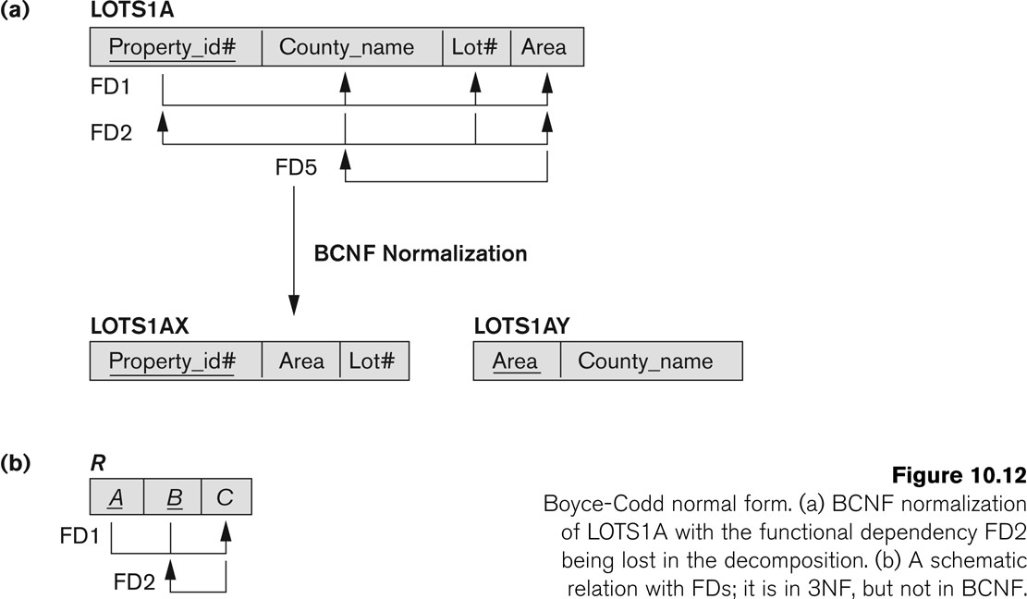
Boyce-Codd Normal form
Go, change the world
RV College of
Engineering

Slide 67
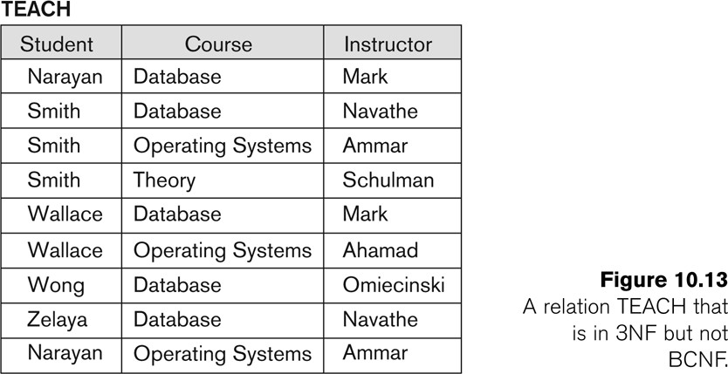
A relation TEACH that is in 3NF but not in BCNF
Go, change the world
RV College of
Engineering
Key: Student Course Student Instructor
Dependencies
Stud Course →Instructor Stud Instructor→Course Instructor→Course

Slide 68
Achieving the BCNF by Decomposition
Go, change the world
RV College of
Engineering
Three possible decompositions for relation TEACH
{student, instructor} and {student, course}
{course, instructor } and {course, student}
{instructor, course } and {instructor, student}
All three decompositions will lose FD { student, course} → instructor
We have to settle for sacrificing the functional dependency preservation. But we cannot sacrifice the non-additivity property after decomposition.
Out of the above three, only the 3rd decomposition will not generate spurious tuples after join.(and hence has the non-additivity property – to be discussed later) .

Slide 69
Go, change the world
RV College of
Engineering
Thank YOU

